Slide 1
belVEDERE tRADING
Project lab final presentation
Implied Volatility Term Structure Study

Slide 2
General goal
Identify the drivers and patterns of the change
Use them to predict the SPX implied volatility term structure changes
Summer
Autumn
Data processing
Dimensional reduction – PCA analysis and feature selection
Model – Regression model and Time series model
Comparison
Stochastic model (Double Stochastic Dynamics)
Define objective function
Find optimal global initial parameter settings
Parameters distribution analysis
Predictor analysis

Slide 3
agenda
Model introduction
The objective functions
The global initial/prior parameters setting
The fitting results
Result analysis
Parameter distribution and outlier analysis
Predictor analysis
Improvements

Slide 4
Model Introduction

Slide 5
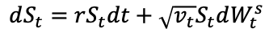
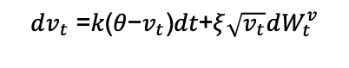
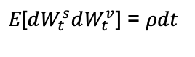
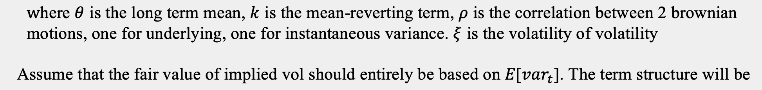
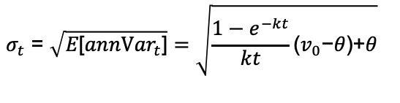
Single stochastic model
First consider Single Stochastic Dynamics, Heston model:

Slide 6
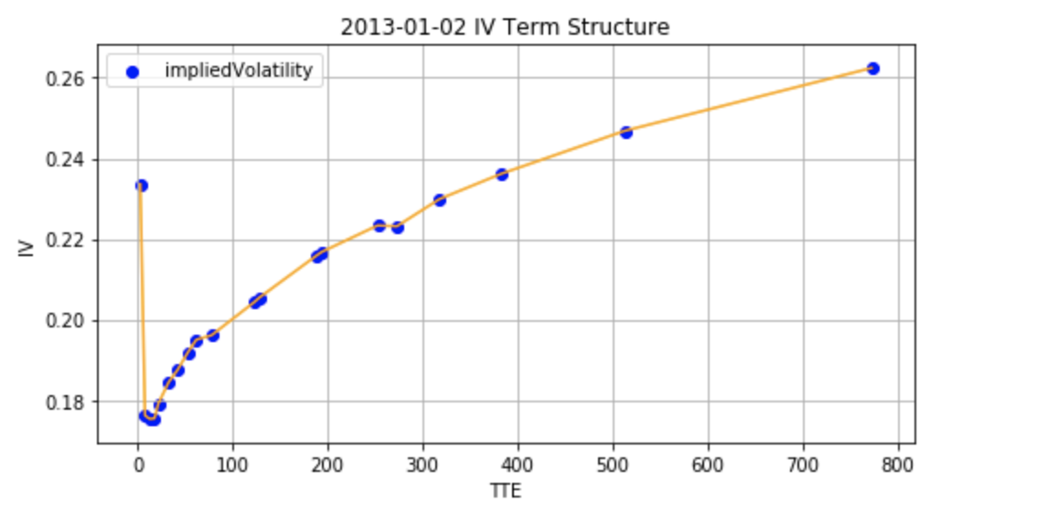
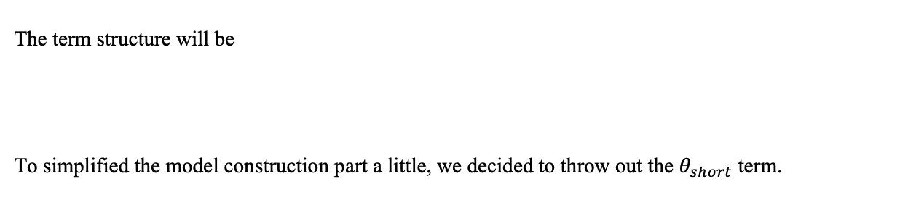
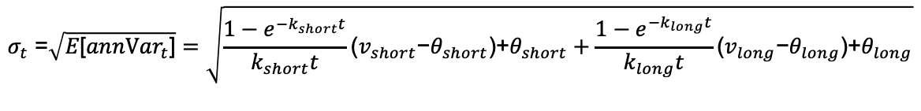
Limitation & Double stochastic model
Limitation:
Consider that the single stochastic dynamic can only fit the monotonic nonlinear model
Assume the model has only one decay factor k

Slide 7
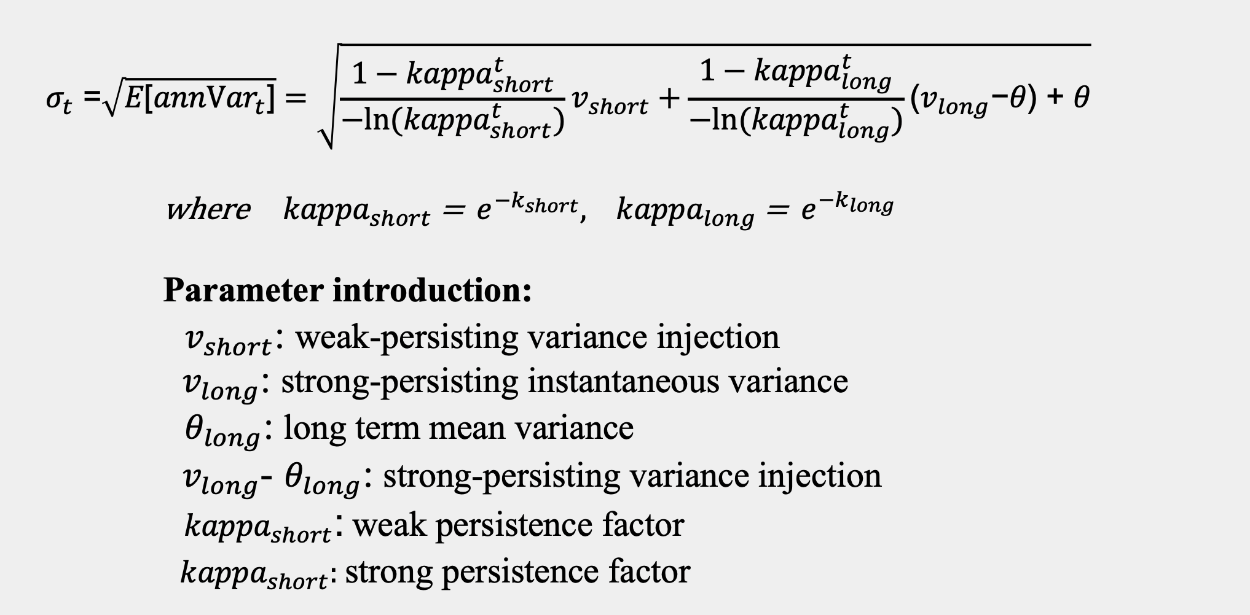
Double stochastic model

Slide 8
The objective function

Slide 9
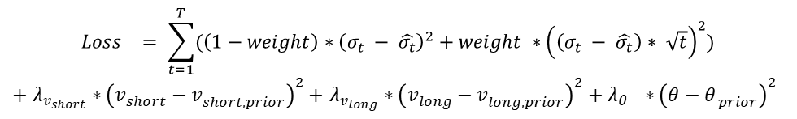
OBJECTIVE FUNCTION
Loss Function (weighted sum of squared vol and dollar error plus L2)

Slide 10
FITTING METHODS
Optimizer without Constraints
Scipy.optimize.minimize(method = ‘Nelder-Mead’)
Scipy.optimize.minimize(method = ‘BFGS’)
Optimizer with Constraints
Scipy.optimize.minimize(method = ‘SLSQP’)
Optimizer with Iterative Random Jumps
Scipy.optimize.basinhopping(method = arbitrary, w/o constraints)

Slide 11
PRIOR SETTING AND INITIAL VALUES

Slide 12
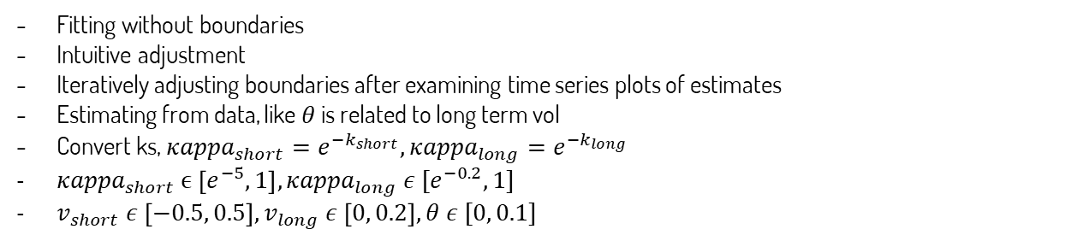
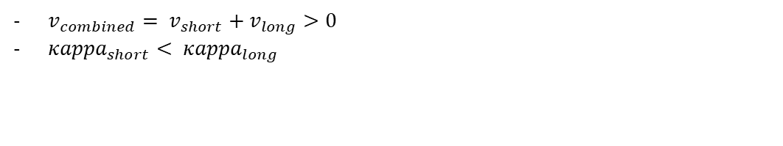
BOUNDARIES AND CONSTRAINTS
How to come up with reasonable boundaries
How to come up with reasonable constraints

Slide 13
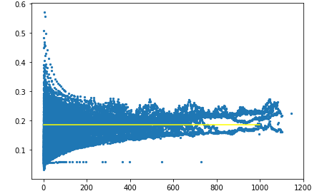
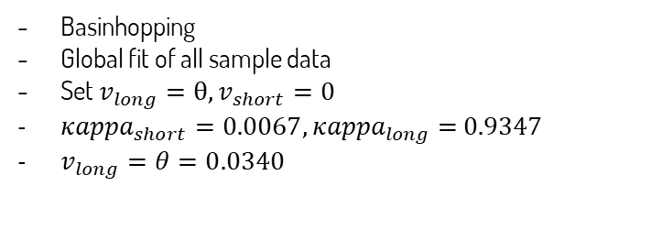
PRIOR SETTING
How to find the prior setting of estimates

Slide 14
Initial values
Fixed initial values
Combined initial values
Set initial values = global fit
Fix the initial values for each day
Pros:
- Easy to implement
- Estimates are around global fit
Cons:
- Unable to capture continuous
information from market
Set initial values = global fit, generate two sets
We compare using two sets, one is the global fit and the other is updated initials
Optimizing rule: whichever minimizes MSE is the optimized estimates on each day
Updating rule: last day’s optimized estimates is the updated initial values set for today
Pros:
- Align with the goal of minimize loss function
- Able to capture continuous information from market
Cons:
- Estimates may have jumps, but understandable

Slide 15
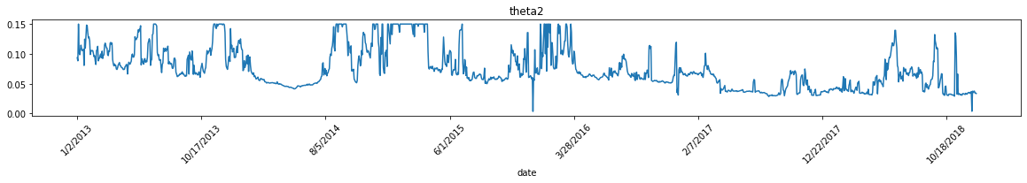
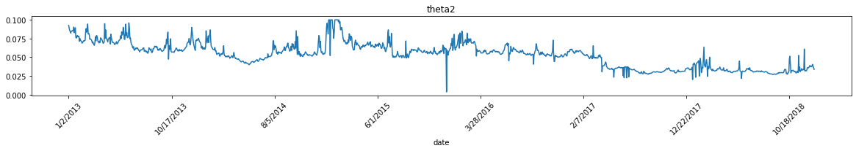
Regularization
Ridge
Pulling estimates to global fit and stopping estimates going out of reasonable bounds
Tradeoff: best shape of vol term structure fitting vs. smooth time series model estimates
Effects

Slide 16
Fitting Results

Slide 17
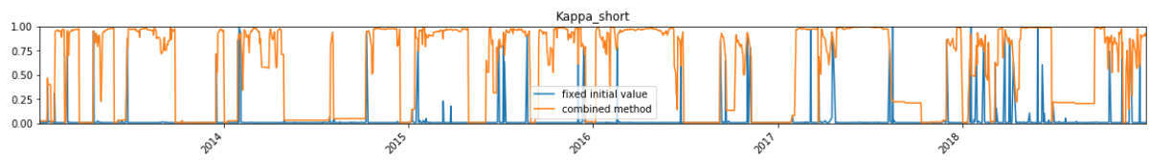
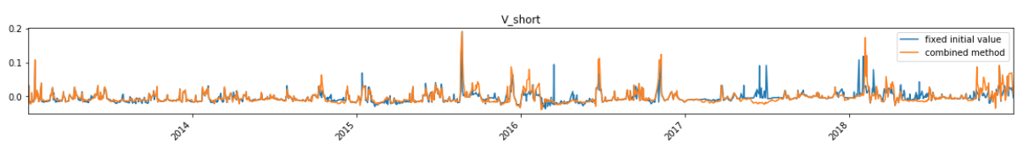
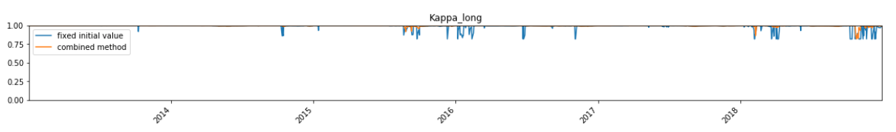
PARAMETER TIME SERIES
Notes:
Fixed initial and combined initial

Slide 18
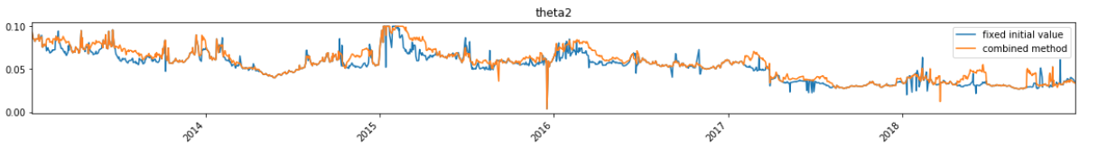
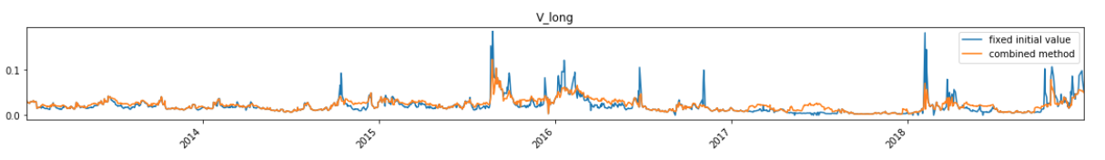
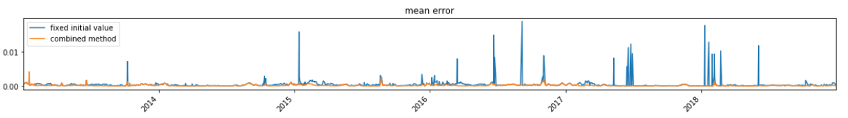
PARAMETER TIME SERIES (CONT’D)

Slide 19
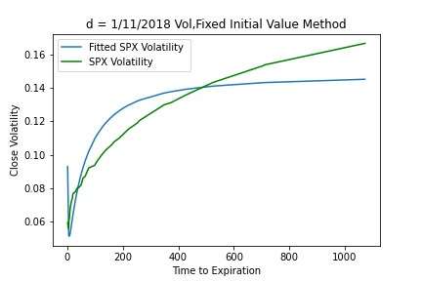
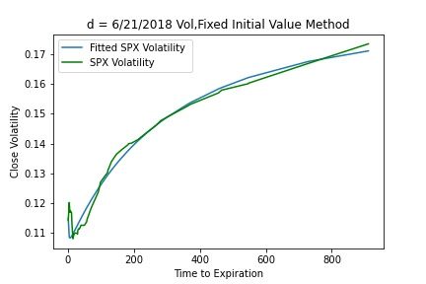
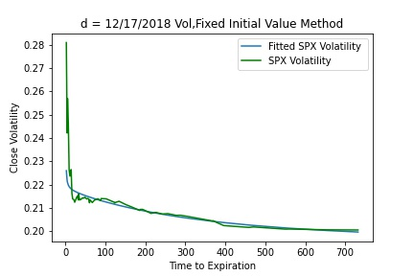
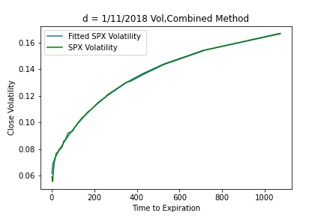

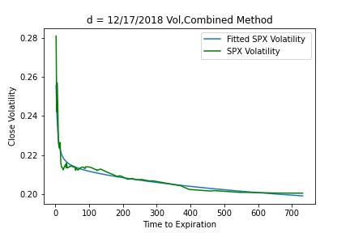
Sample vol curve
FIXED INITIAL VALUE METHOD
COMBINED METHOD
The combined initial value method can capture the change of vol curves in different shapes, and the expiration-day effect better.

Slide 20
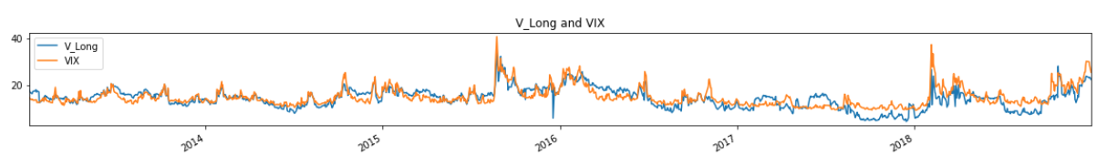
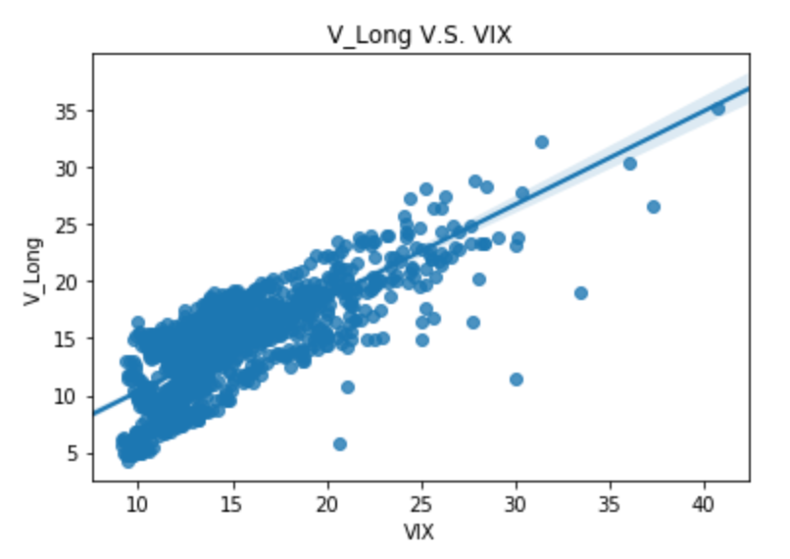
RESULT ANALYSIS
V_LONG V.S. VIX
The correlation between V_Long and VIX is 0.8106.
The slow-reverting instantaneous vol can capture most of the VIX change.
* V_Long is transformed to vol points term (on the same basis as VIX).
Notes:
Vol based on v_long

Slide 21
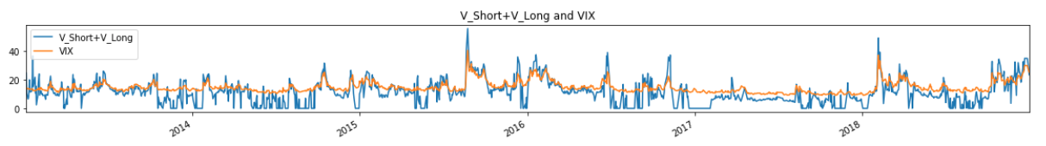
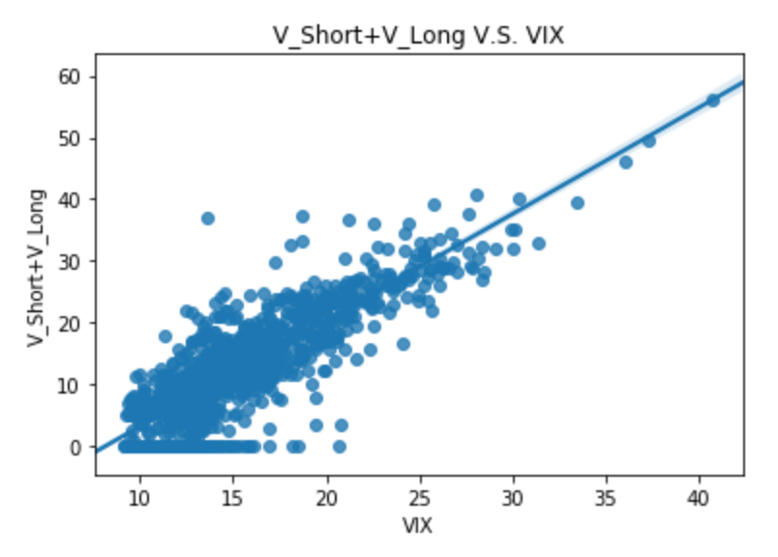
RESULT ANALYSIS (CONT’D)
V_COMBINED V.S. VIX
Higher Correlation: The correlation between V_Combined and VIX is 0.8543.
The total instantaneous vol sums up the long-term and short-term VIX change.
Potential Problem:
Set Theta_Short to be zero
Scaling over time
* V_Combined (V_Long + V_Short) is transformed to vol points term.
Notes:
V_Combined

Slide 22
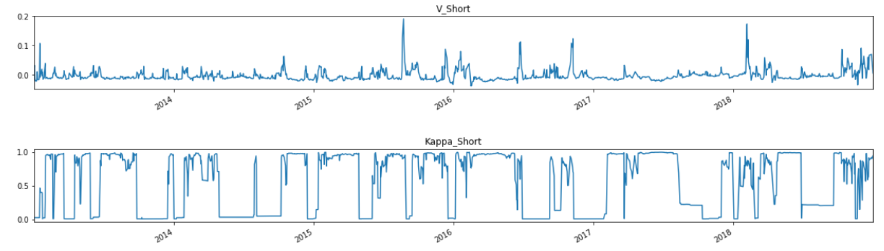
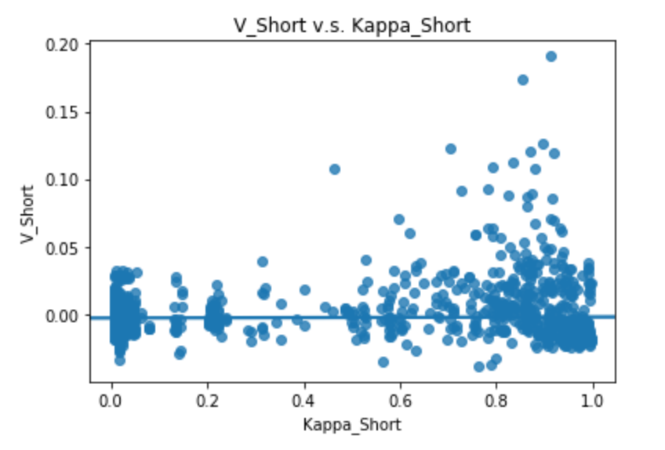
RESULT ANALYSIS (CONT’D)
V_SHORT V.S. KAPPA_SHORT
The correlation between v_Short and Kappa_Short is 0.0157.
The weak persistence factor and the weak-persisting variance injection have very low correlation in our model.
The short-term change has more noise.

Slide 23
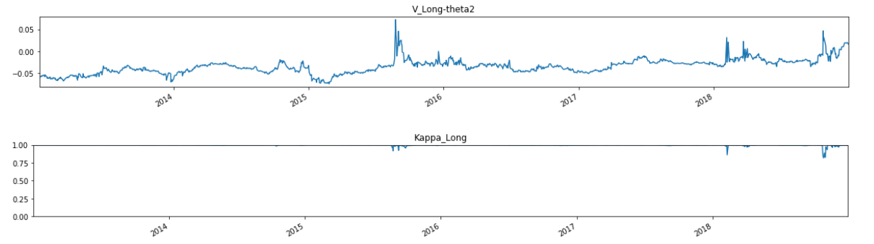
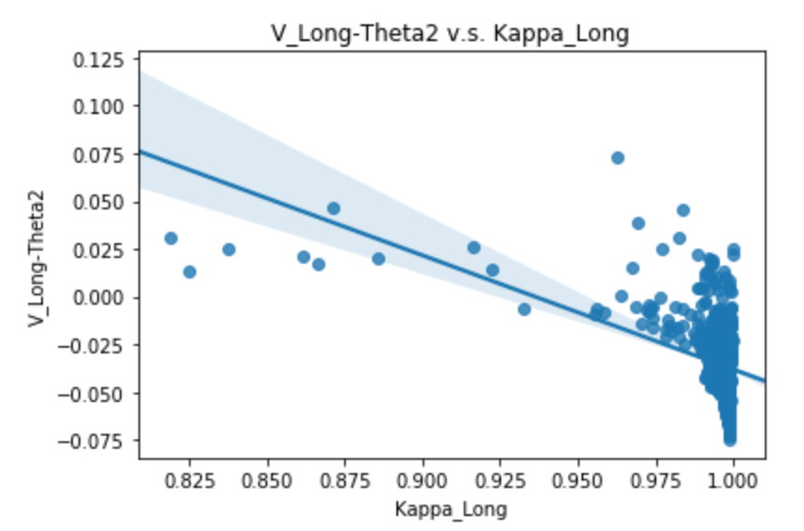
RESULT ANALYSIS (CONT’D)
V_LONG - THETA V.S. KAPPA_LONG
The correlation between V_Long-Theta2 and Kappa_Long is -0.4098..
The decay factors are concentrated to the level of 1, showing the constant volatility change pattern.
Potential Problem: The constraint of Kappa

Slide 24
Distribution ANALYSIS

Slide 25
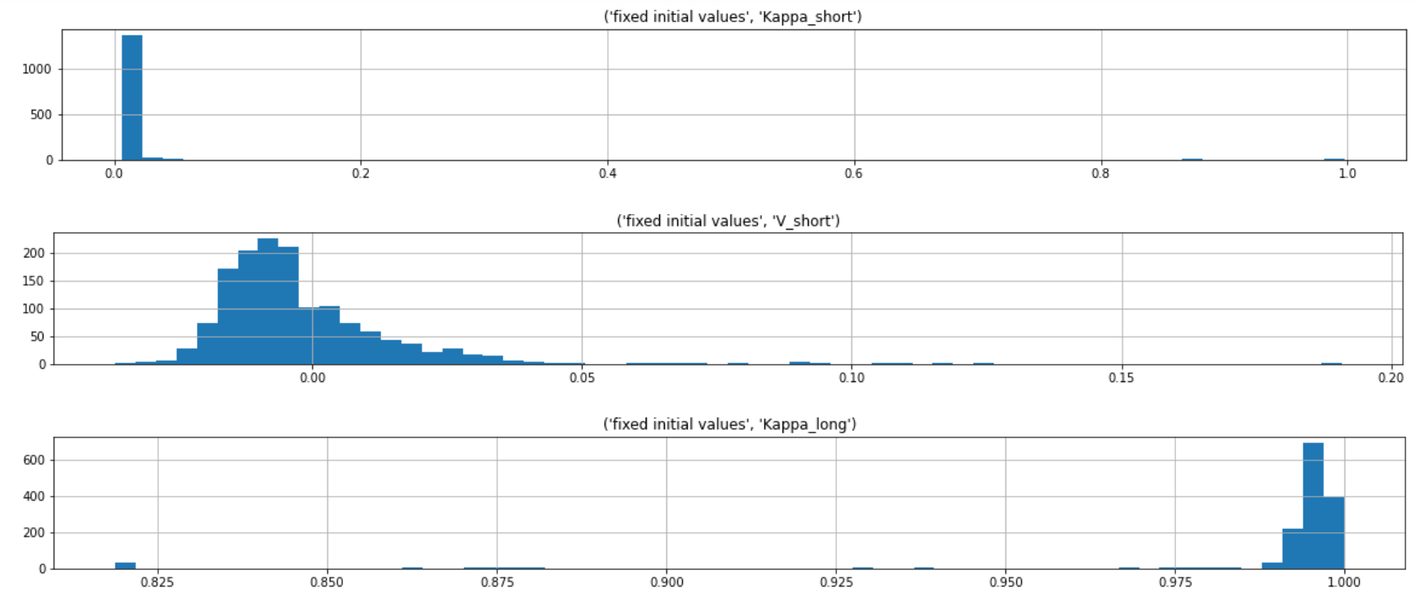
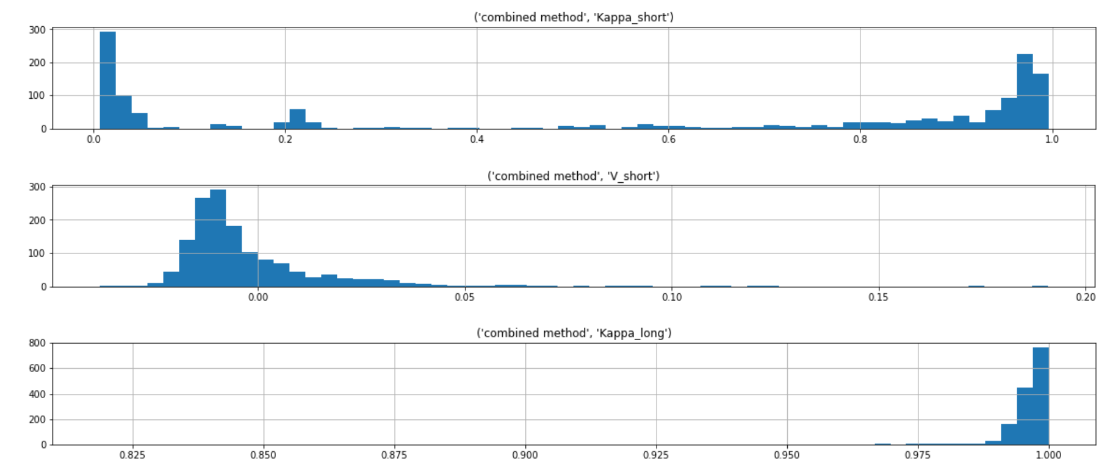
Parameter distribution
FIXED INITIAL VALUE METHOD
COMBINED INITIAL VALUE METHOD

Slide 26
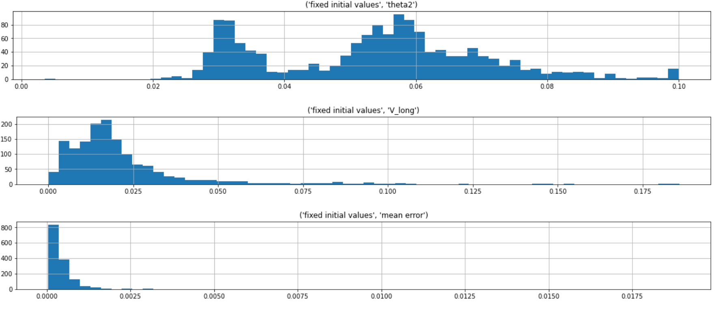
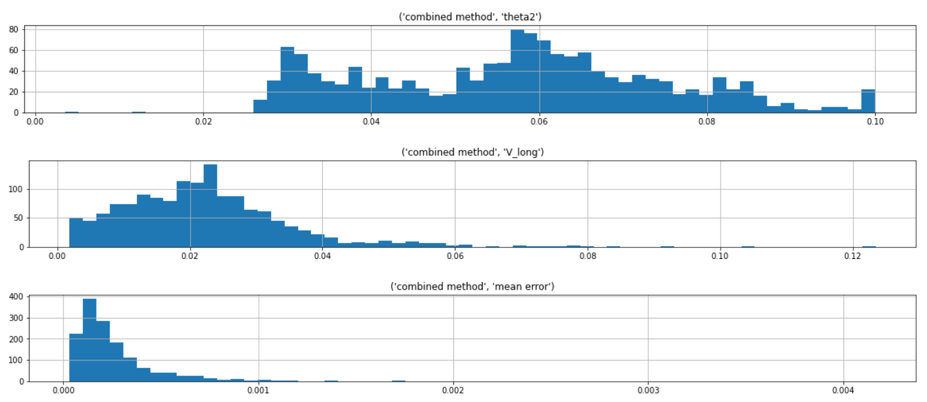
Parameter distribution (CONT’D)
FIXED INITIAL VALUE METHOD
COMBINED INITIAL VALUE METHOD

Slide 27
Outlier ANALYSIS
OUTLIER STATISTICS
Parameters | Number of Outliers (Fixed Initial Value) | Number of Outliers (Combined Initial Value)
Kappa_Short | 55 | 0
V_Short | 17 | 29
Kappa_Long | 57 | 13
theta2 | 1 | 1
V_Long | 39 | 17
Total | 139 | 51

Slide 28
Outlier analysis - reasons and how to improve
Days Accounting
We use weekdays to calculate days to expiration. In reality, there might be bunch of holidays which we haven’t accounted for.
Some firms in the industry also count partial days for weekend, because non-market events can still happen and will cause some jump variance to Monday open. We can, for example, count weekend as half day. This way, if you are trading a Monday expiration option on Friday open, you will regard this option as a 2.5 day option, not 2 day option.
Some expirations are AM and some are PM, which isn’t shown in our data. Inaccurate days accounting can definitely cause data points on vol term structure to misplace, therefore throwing off our fitted parameters.

Slide 29
Outlier analysis - reasons and how to improve
Event Variance
Certain event are already put on calendar like FOMC meeting, Brexit, ect. They will injection some variance in the middle of a vol term structure.
Our model’s source of variance injection is only at the front.
In practice, if we have confident estimate of those event variances, we can simply take them out, and look at event-free vol term structure, which presents not theoretical problem for using our model.
Maybe 2 sources of stochastic vol aren’t enough. But adding more will definitely complicate our model.

Slide 30
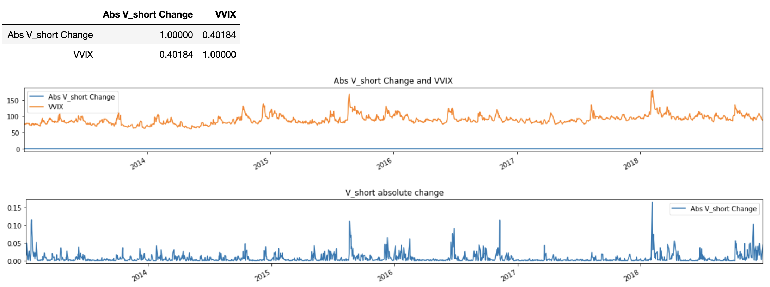
Correlations: Predictors and Change in V values:
V_short, V_long, V_Combined and VVIX, SPX Return, SPX Return^2
Absolute V_short Change and VVIX where V_short is weak-persisting variance injection

Slide 31
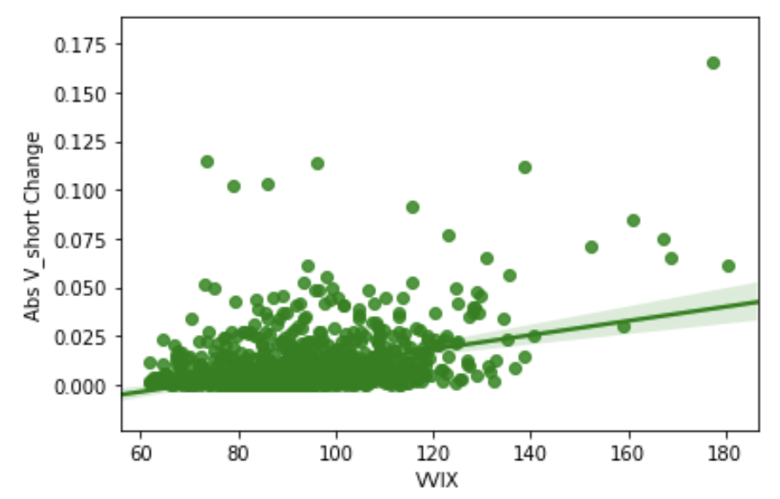
Correlations: Predictors and Change in V values:
V_short, V_long, V_Combined and VVIX, SPX Return, SPX Return^2
Absolute V_short Change and VVIX where V_short is weak-persisting variance injection
Notes:
Abs change

Slide 32
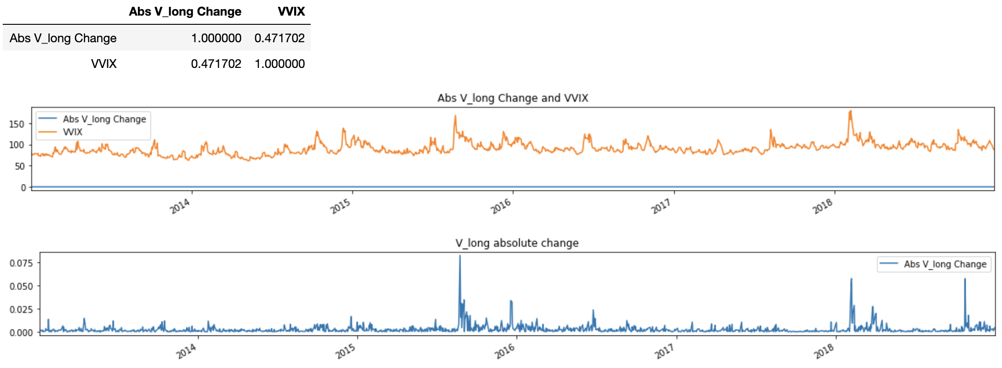
Correlations: Predictors and Change in V values:
V_short, V_long, V_Combined and VVIX, SPX Return, SPX_Return^2
Absolute V_long Change and VVIX where V_long is strong-persisting instantaneous variance
Notes:
32-35: Spx return, SPX return squared

Slide 33
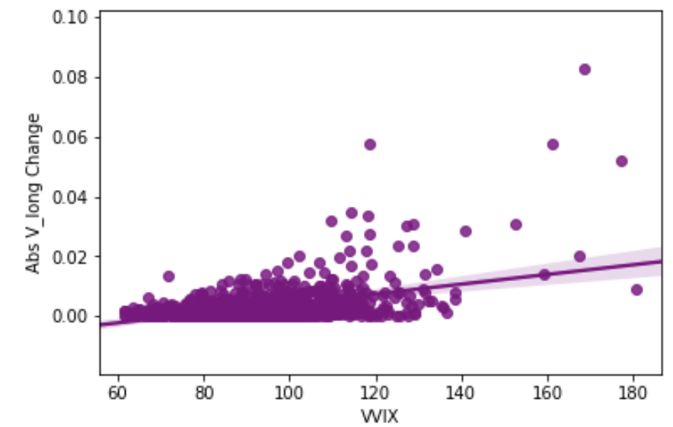
Correlations: Predictors and Change in V values:
V_short, V_long, V_Combined and VVIX, SPX Return, SPX_Return^2
Absolute V_long Change and VVIX where V_long is strong-persisting instantaneous variance

Slide 34
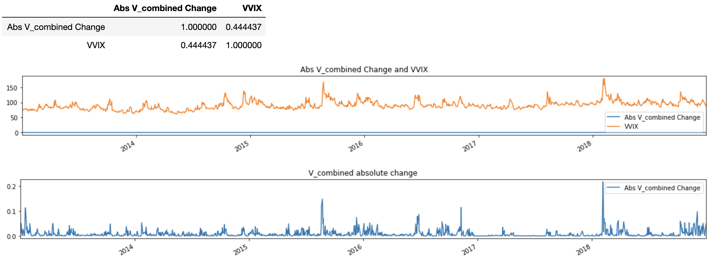
Correlations: Predictors and Change in V values:
V_short, V_long, V_Combined and VVIX, SPX Return, SPX_Return^2
Absolute V_combined Change and VVIX where V_combined = V_short+V_long

Slide 35
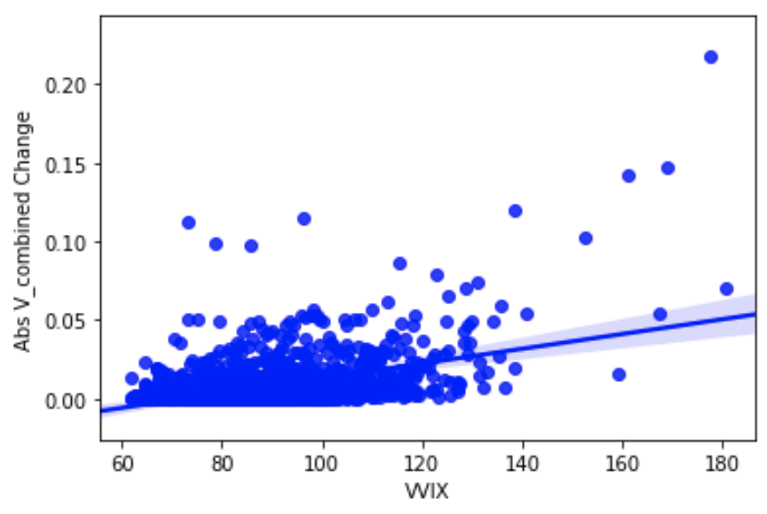
Correlations: Predictors and Change in V values:
V_short, V_long, V_Combined and VVIX, SPX Return, SPX_Return^2
Absolute V_combined Change and VVIX where V_combined = V_short+V_long

Slide 36
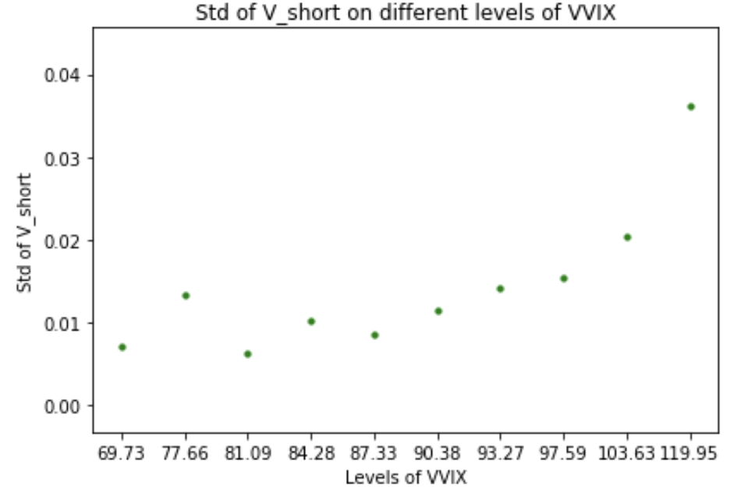
Correlations: V_short, V_long,VIX, VVIX
(STD of V_short) and VVIX in 10 percentiles: [0.1,0.2,0.3,...,1.0]

Slide 37
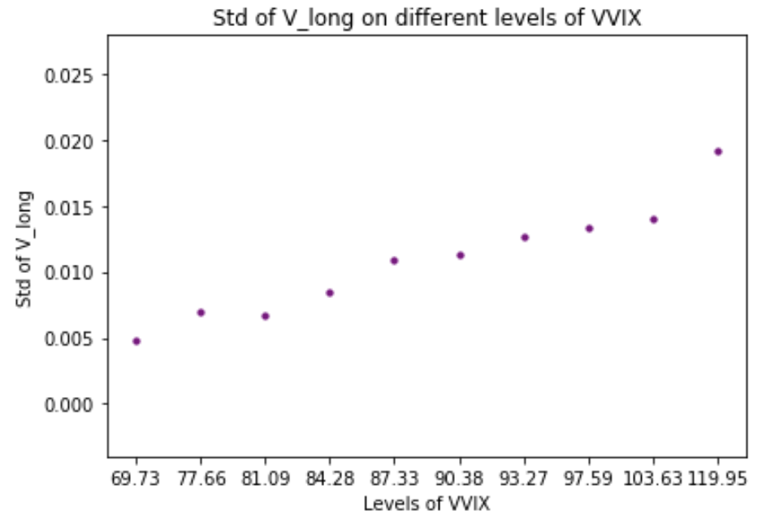
Correlations: V_short, V_long,VIX, VVIX
(STD of V_long) and VVIX in 10 percentiles: [0.1,0.2,0.3,...,1.0]

Slide 38
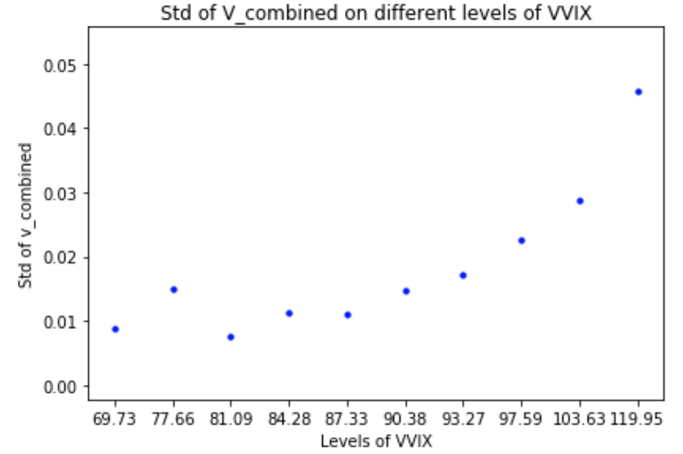
Correlations: V_short, V_long,VIX, VVIX
(STD of V_combined) and VVIX in 10 percentiles: [0.1,0.2,0.3,...,1.0]

Slide 39
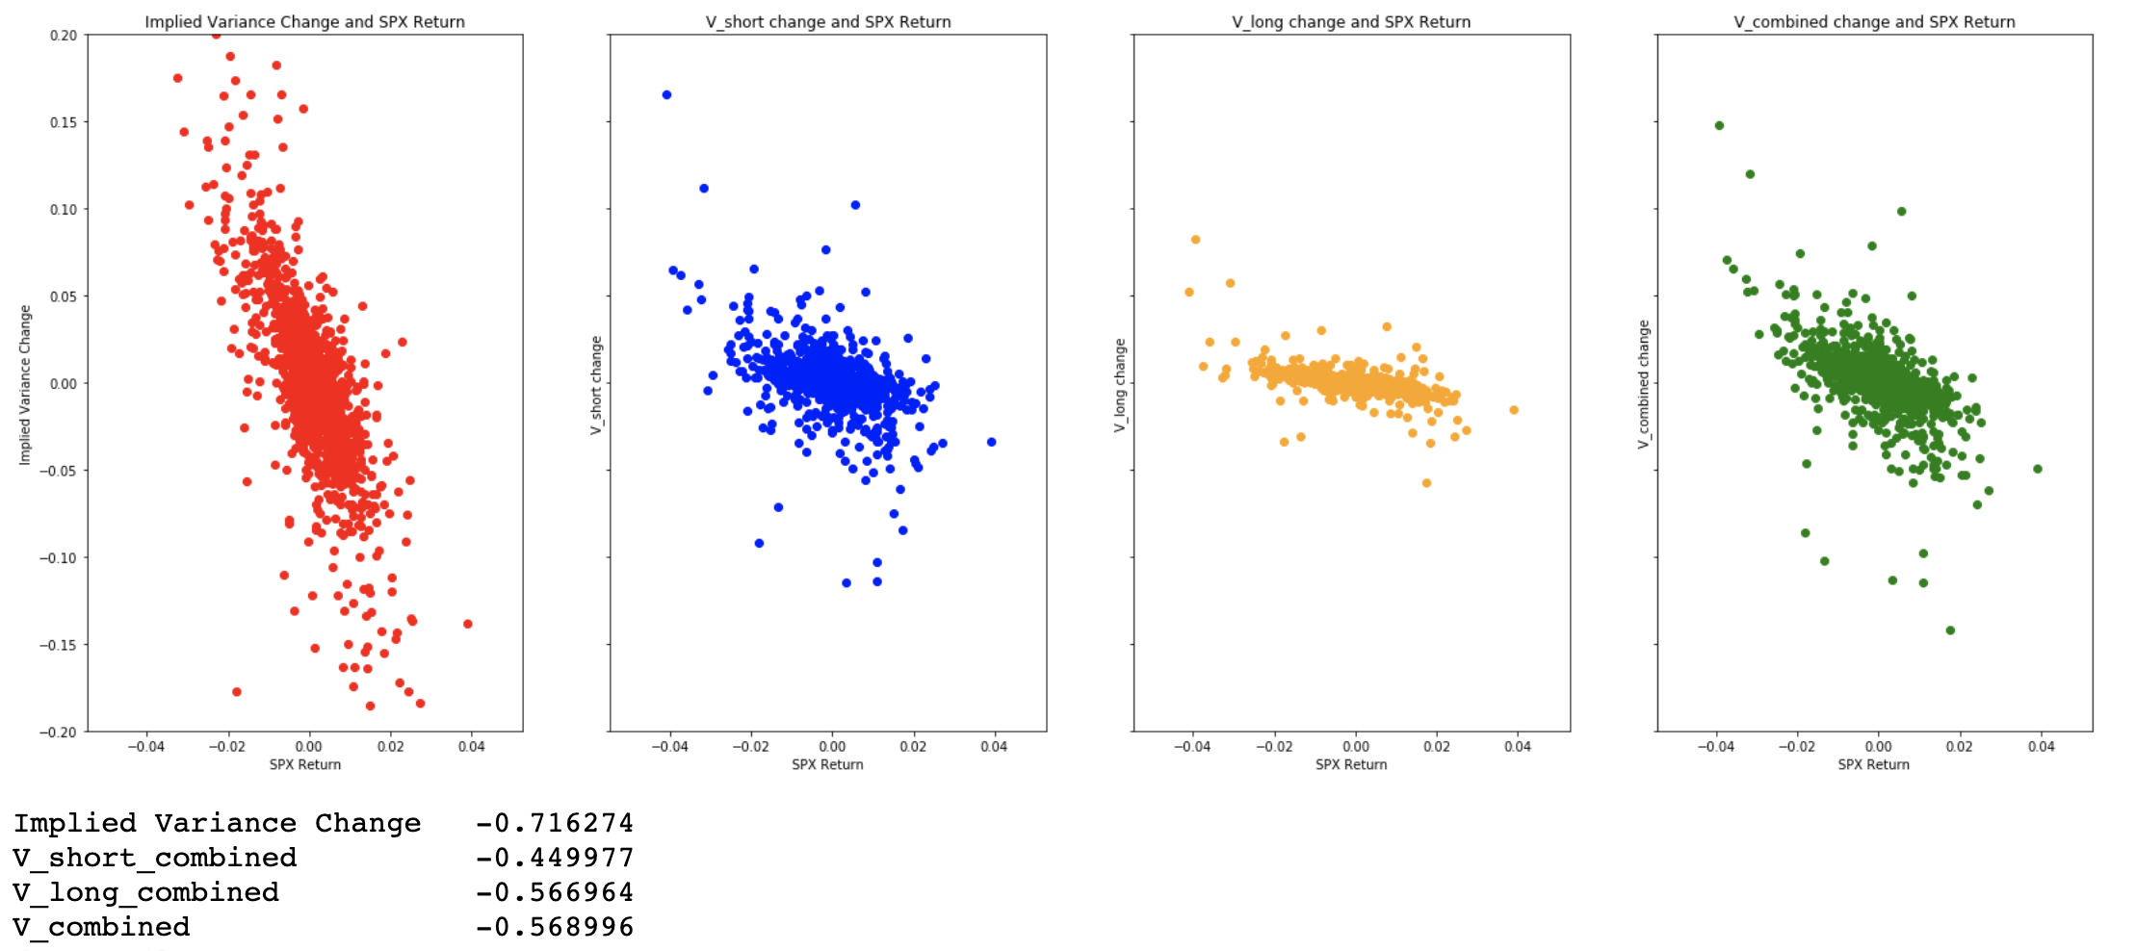
Correlations: V_short, V_long, V_0, SPX, Implied_vol
Implied Variance Change, V_short Change, V_long Change, V_combined Change and SPX Return
Note: implied variance is the interpolated from volatility curve using at 5-day TTE
Notes:
Vol curve change = d(volcurve)/d(v_short)(K_short) * beta(v_short~spxret) Vol curve change (all expirations) / spxret

Slide 40
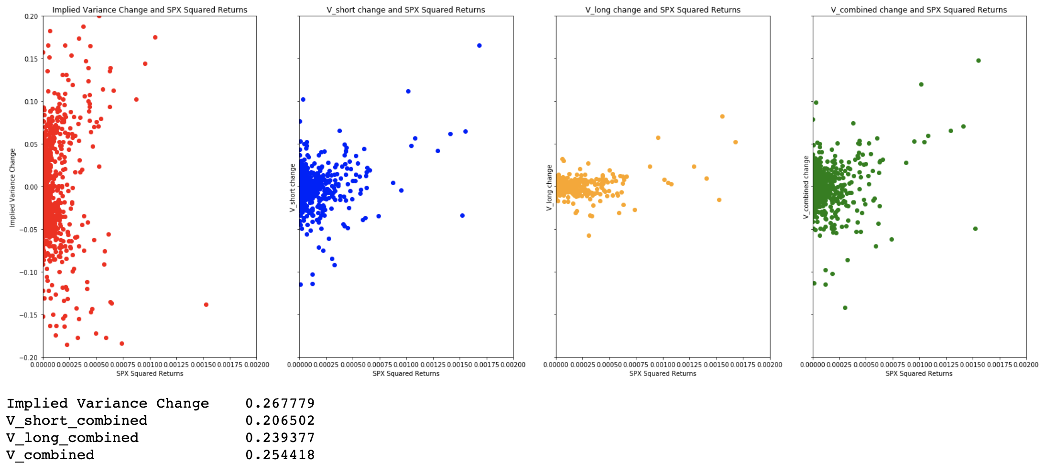
Correlations: V_short, V_long, V_0, SPX, Implied_vol
Implied Variance Change, V_short Change, V_long Change, V_combined Change and SPX Return^2

Slide 41
Summary and future improvements: summary
Double Stochastic Model replaced PCA and studied the dynamics of parameters
Optimization:
Objective Function: mix_sum_of_squares, mix_sum_of_squares_ridge
Boundary & Constraints: Ks(mean_reverting term), Vs(instantaneous variance term), Theta (long-term mean variance term)
Prior Values: Basinhopping method to find prior values
Optimizer: run optimizer year by year
Estimated Parameters: the dynamics of parameters combining initial values and yesterday’s fit
Outlier Analysis: check if the fit is good - check how many trading dates where outliers were shown
Predictors & parameters

Slide 42

Summary and improvements: improvements
Any questions?
Thank you
Construct regression model based on relationships in predictors and parameters for predictions
Out-of-sample backtesting to compare the performance of predictions
Adjust constraints for Basinhopping to get better estimations
Consider vol_curve_change = d(vol_curve)/d(v_short)(K_short) * [beta(v_short~spxret)
+beta(v_short~spxret^2)+beta(v_short~dt)]+d(vol_curve0/d(v_long)(K_long).... And possibly other factors if we could find reliable predictors such as d(vol_curve)/d(K_long)*beta(K_long~predictor)
Notes:
vol_curve_change = d(vol_curve)/d(v_short)(K_short) * [beta(v_short~spxret)+beta(v_short~spxret^2)+beta(v_short~dt)]
+d(vol_curve0/d(v_long)(K_long).....
And possibly other factors if we can find reliable predictors, like d(vol_curve)/d(K_long)*beta(K_long~predictor)

